Slide 1

.
Practical no-1

Slide 2
Study basic SQL statements .
Query to study CREATE table command
Query to study ALTER table commands
Query to study DROP table command
Query to study RENAME table command
Query to study INSERT command
Query to study UPDATE command
Query to study DELETE command

Slide 3
Objective
1. Data Definition
Objective: Define and manage the structure of the database schema.
2. Data Manipulation
Objective: Insert, update, delete, and retrieve data from tables.
Data Retrieval and Querying
Objective: Retrieve and query data to answer questions and generate reports.
Security and Access Control
Objective: Manage user access and ensure data security.

Slide 4
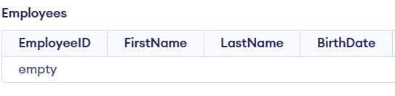

CREATE TABLE Command
The CREATE TABLE command is used to create a new table in the DATABASE
QUERY
CREATE TABLE Employees ( EmployeeID INT PRIMARY KEY, FirstName VARCHAR(50), LastName VARCHAR(50), BirthDate DATE, HireDate DATE, Salary DECIMAL(10, 2) );
.
OUTPUT

Slide 5


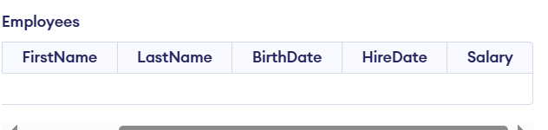
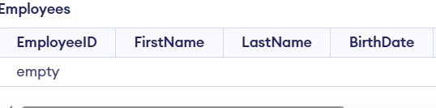
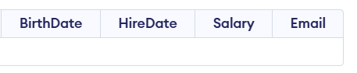

2.ALTER TABLE Command
The ALTER TABLE command is used to modify an existing table's structure.
Add a new column:
Computers have widespread applications across various industries and aspects of our lives.
Remove a column:
QUERY:
Business
Accounting, inventory management, marketing, and customer relationship management
ALTER TABLE Employees
ADD Email VARCHAR(100);
OUTPUT
ALTER TABLE Employees
DROP COLUMN Email;
OUTPUT
Education
Research, online learning platforms, and educational software
Healthcare
Diagnosis, treatment planning, medical imaging, and patient records management
Entertainment
Gaming, music streaming, video editing, and movie production

Slide 6





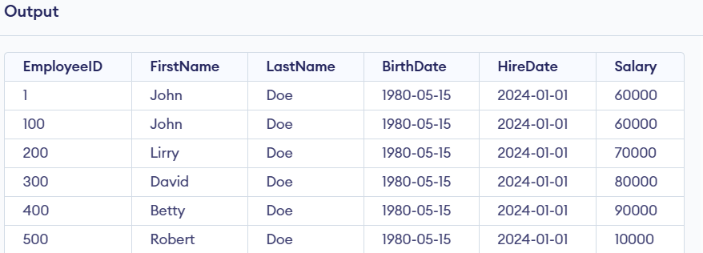


3.INSERT TABLE Command
Impact of Computers on Society
The INSERT command is used to add new rows of data to a table.
Computers have profoundly impacted society, transforming how we live, work, and interact with each other.
QUERY:
Increased Efficiency
INSERT INTO Employees VALUES
(100, 'John', 'Doe', ’05-15-2000', ‘01-01-2024', 60000.00)
SELECT * FROM Employees;
Computers have automated tasks, freeing up human time and resources.
Global Connectivity
Computers have facilitated communication and collaboration across the globe.
New Technologies
Computers have driven the development of new technologies, such as the internet, smartphones, and artificial intelligence.

Slide 7




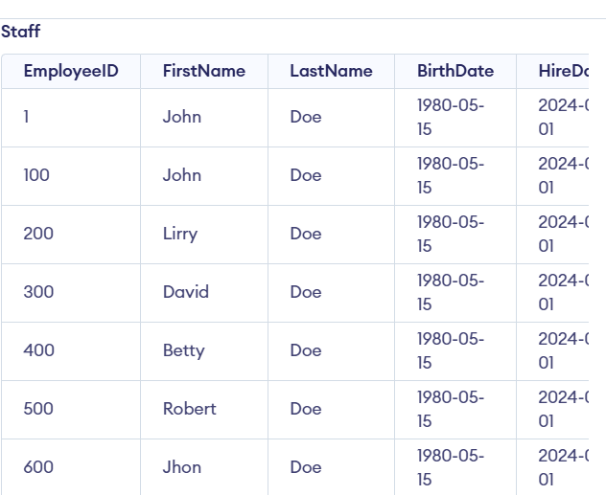
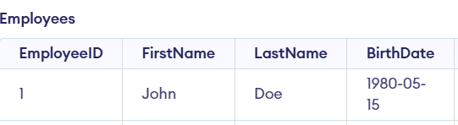
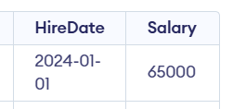


Advantages of Computers
5. RENAME TABLE Command
4. UPDATE TABLE Command
Computers offer numerous advantages, contributing to progress and innovation.
QUERY
QUERY
ALTER TABLE Employees RENAME TO Staff;
UPDATE Employees
SET Salary = 65000.00
WHERE EmployeeID = 100;
Speed and Accuracy
Storage Capacity
Computers can perform complex calculations and tasks with remarkable speed and accuracy.
Computers can store vast amounts of data and information, making it easy to access and retrieve information.
OUTPUT
OUTPUT
Connectivity
User Friendliness
Computers facilitate communication and collaboration through networks and the internet.
Modern computer interfaces are designed to be user-friendly, making them accessible to a wide range of users.

Slide 8

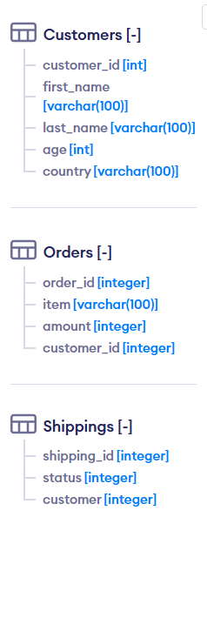

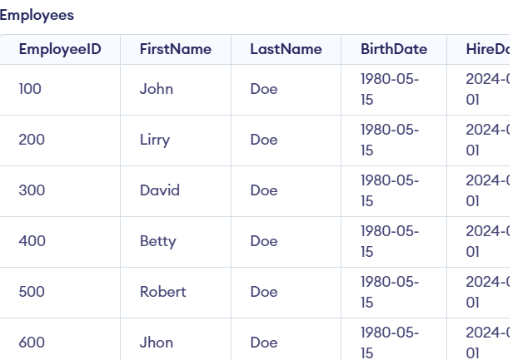
6. DELETE Command
The DELETE command is used to remove rows from a table.
7. DROP Command
The DROP TABLE command is used to delete a table and its data from the database.
QUERY
DELETE FROM Employees
WHERE EmployeeID = 100;
DROP TABLE Employees;
OUTPUT
OUTPUT
Conclusion
Computers have become indispensable tools in our modern world, revolutionizing various aspects of our lives. They continue to evolve and offer new possibilities, shaping the future of technology and society.

